Slide 1
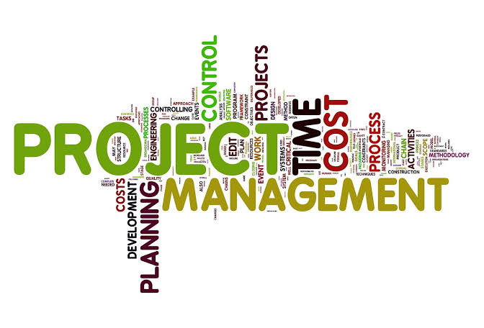
Dr. Farrukh Zeshan

Slide 2
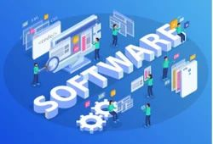
Software
Can we call a program ‘software’ ?
Software is not just a program
  Program: code
  Data: The data on which the program operates is also considered a part of the software.
  Documentation: An important component.

Slide 3
Project
A temporary endeavor undertaken to create a unique product, service or result.
Definite beginning and a definite end
Does not mean short duration
Produce a product or artifact, quantifiable, an end item or a component item
A capability to perform a service, such as call center
A result, such as research results or documents.

Slide 4
Management
Management is the process of planning, directing, monitoring and controlling resources and activities to achieve defined project objectives within agreed constraints.

Slide 5
What is software project management?

Slide 6
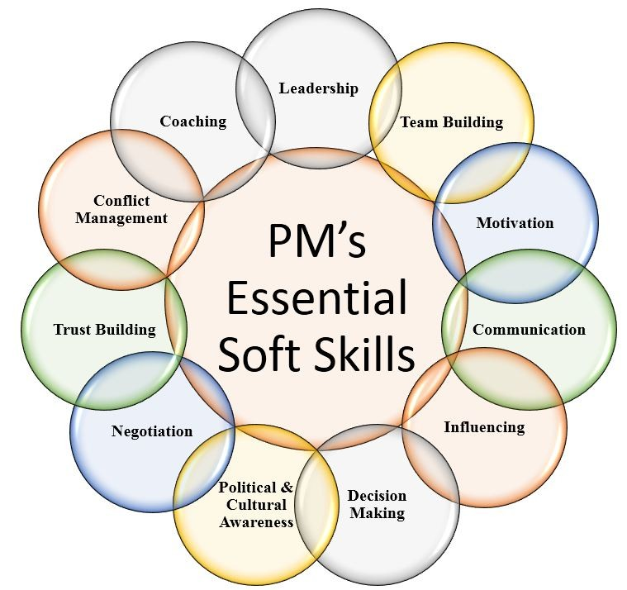

Slide 7
Project Initiation
Meeting regulatory, legal, or social requirements;
Satisfying stakeholder requests or needs;
Implementing or changing business or technological strategies;
Creating, improving, or fixing products, processes, or services

Slide 8
Operations
Operations are an organizational function performing an ongoing execution of activities.
Examples: Production, manufacturing, and accounting operations.
Projects help achieve the organizational goals when they are aligned with the organization’s strategy.
Projects require project management while operations require business process management (BPM) or operations management.

Slide 9

Good Software?
Deliver the required functionality.
Maintainable
Reliable
User-friendly
Performance
Quality
Cost-effective
Software is getting slower more rapidly than hardware becomes faster

Slide 10
Key challenges?
Heterogeneity
  Software that can cope with heterogeneous platforms and execution environments;
Global Software Development
ML / DL
IoT & Edge Devices
Talent Shortage demand for experts
Technology: cybersecurity, blockchain, web 3.0

Slide 11

Complexity?
A "simple" system has a small number of interactions within the system / environment.
A system with high interactions reaches the point where they cannot be thoroughly
Understood
Planned
Estimated
Guarded against

Slide 12
Facts
Risks of cancellation or major delays rise as application size increases
  25 % for those over 100,000 LOC
  65% of large systems (over 1,000,000 LOC) are cancelled before completion
  50% for systems exceeding half million LOC
  Failure or cancellation rate of large software systems is over 20% (Capers Jones)

Slide 13
Facts
After surveying 8,000 IT projects, Standish Group reported about 30% of all projects were cancelled.
Average cancelled project in U.S. is about a year behind schedule and has consumed 200% of expected budget.
Of completed projects, 2/3 experience schedule delays and cost overruns (Capers Jones).

Slide 14
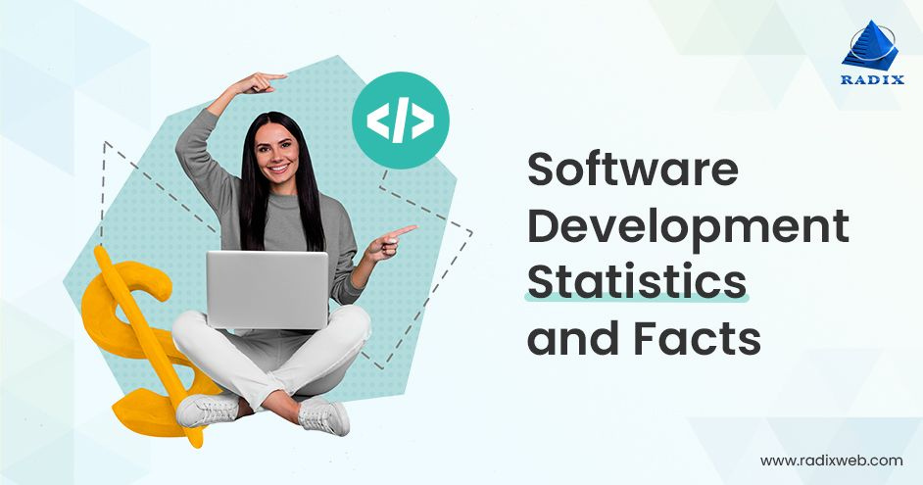
Facts
2/3 of completed projects experience low reliability and quality problems in first year of deployment (Jones).
Software errors in fielded systems typically range from 0.5 to 3.0 occurrences per 1000 lines of code (Bell Labs survey).

Slide 15
Failure Causes
Technology change
Key people left
Cannot test exhaustively
Size of the project relative to previous efforts
Failure to understand requirements
Poor estimation
Etc.

Slide 16

Software Life Span
Many software applications may last for 25 years.
Software engineering needs to consider the many years of maintenance and enhancement after delivery.

Slide 17
Maintenance
For most large, long lifetime software systems, maintenance cost normally exceeds development cost by factors ranging from 2 to 3.
Boehm (1975) quotes a pathological case where the development cost of an avionics system was $30 per line of code but the maintenance cost was $4000 per instruction.

Slide 18

Maintenance
Due to the recession, new development is slowing down, so the economics of software maintenance and renovation need to be better understood.
There are more software engineers working on maintenance than on new development.

Slide 19
Maintenance
Many of the maintenance software engineers are tasked with maintaining applications they did not develop,
Coded in “dead” languages, and
No specifications nor effective comments in the code itself.

Slide 20
Software Challenges
Reusability
Scope
Quality
Time
Cost

Slide 21
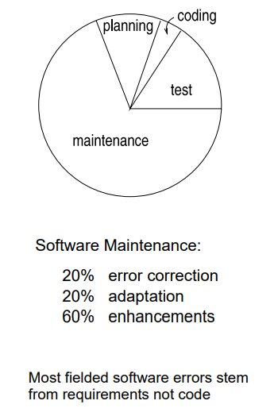
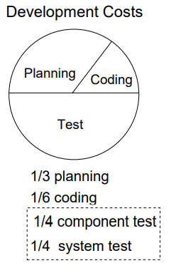

Slide 22
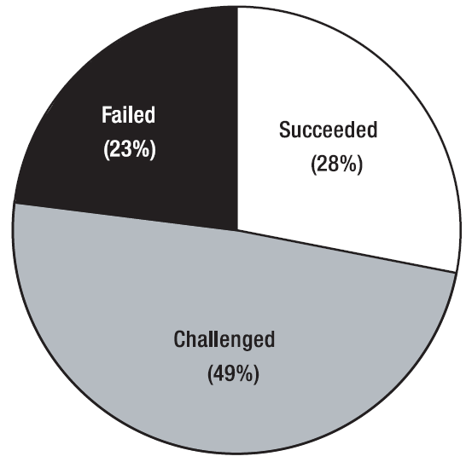
Substantially late by 63 percent
Over budget by 45 percent
Lacking features by 33 percent

Slide 23
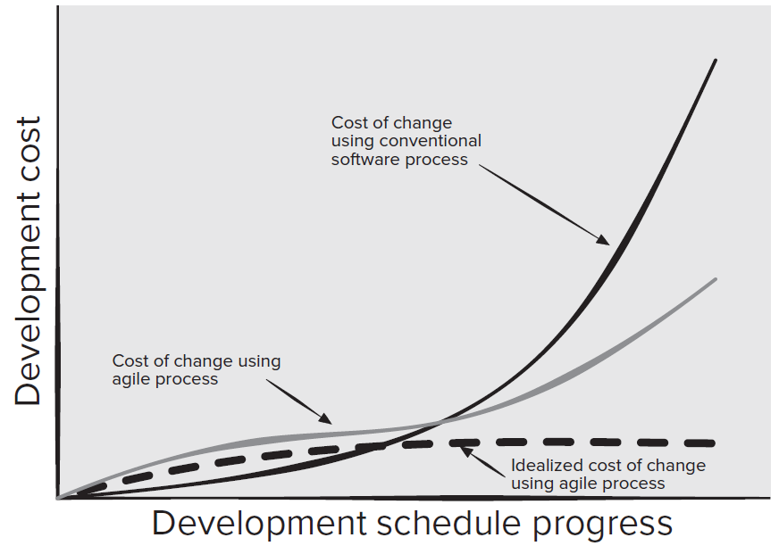

Slide 24
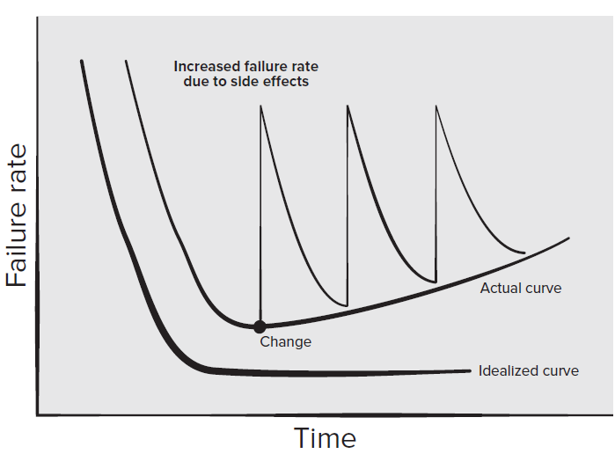
Software doesn’t “wear out.” It deteriorate!

Slide 25
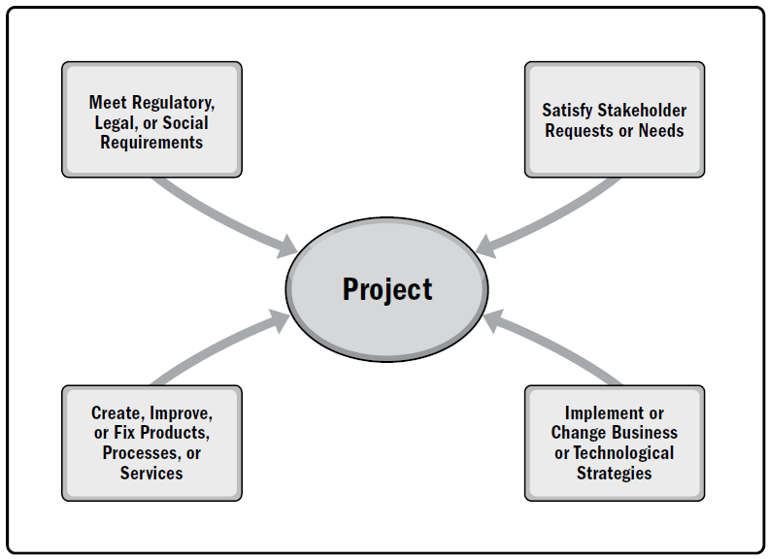

Slide 26
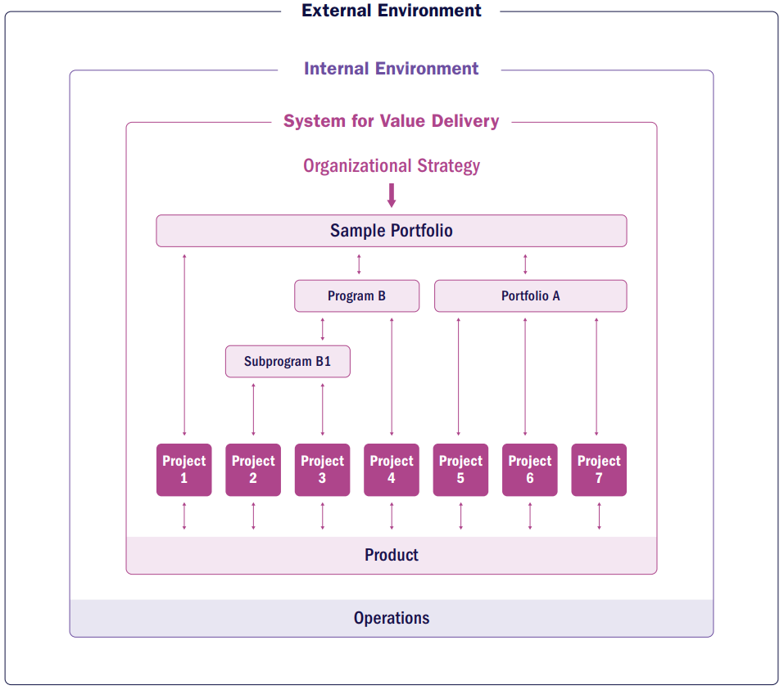
Portfolio, Program and Projects

Slide 27
Internal Environment
Process assets. include tools, methodologies, templates, frameworks.
Governance documentation include policies and processes.
Data assets include databases, document libraries, metrics, data, and artifacts from previous projects.
Knowledge assets include tacit knowledge among project team members, subject matter experts, and other employees.

Slide 28
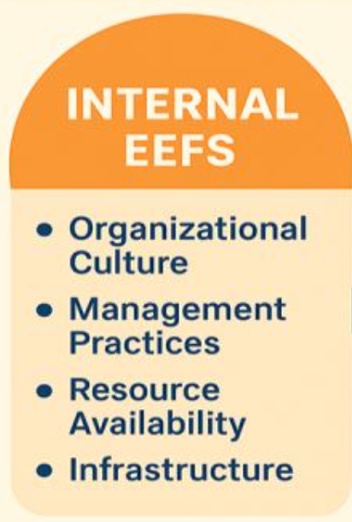
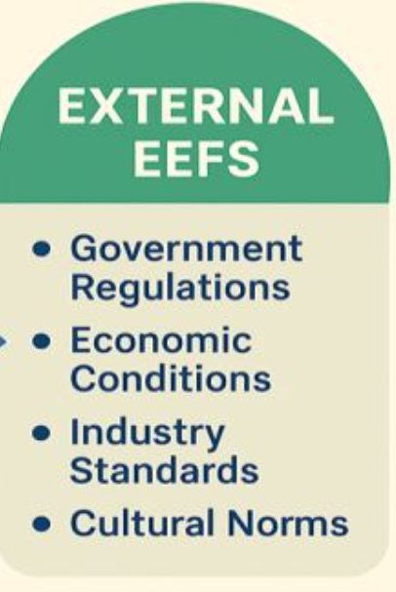

Slide 29
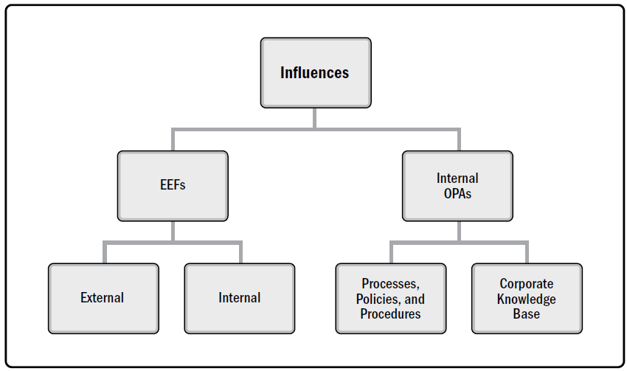

Slide 30

OPA
Guidelines and criteria
Organization standards
  like policies
Templates.
Change control procedure
Issue and defect management procedure

Slide 31
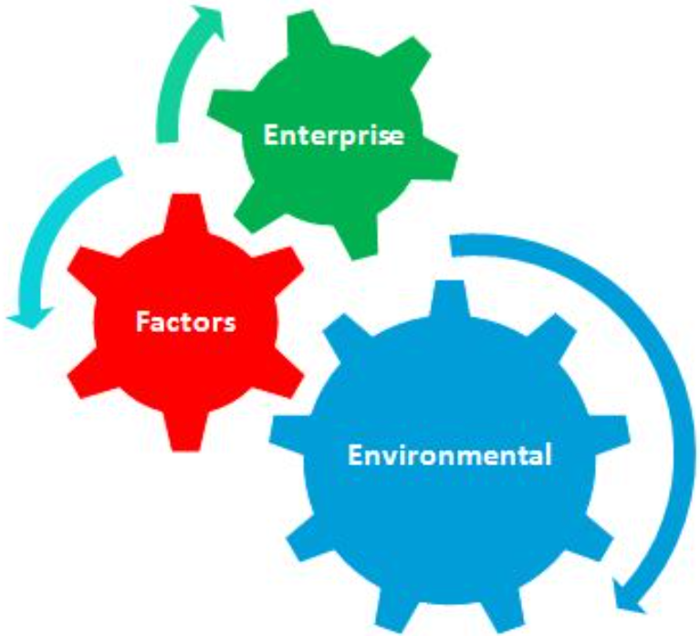
EEF
Organizational culture,
Structure
Governance
Infrastructure
Resource availability
Employee capability
Stakeholders risk tolerance
Communication channel
Political climate

Slide 32
EEF
Marketplace conditions
Regulatory environment
Commercial databases
Currency exchange rates.

Slide 33
Portfolio Management
Portfolio management is defined as the centralized management of one or more portfolios to achieve strategic objectives.
Guide organizational investment decisions.
Increase the likelihood of realizing the desired return on investment.
Centralize the management of the aggregate risk profile of all components.

Slide 34
Program Management
A program is a group of related project, sub-projects, and program activities managed in a coordinated way.
Projects are related through common outcome or collective capability.
Focus on project interdependencies and help determine the optimal approach for managing them. Interdependencies such as:
Resource Constraints
Aligning organizational direction
Resolve issues and change management

Slide 35
Project Management
The application of knowledge, skills, tools, and techniques to project activities to meet project requirements.
Project management refers to guiding the project work to deliver the intended outcomes.
Project teams can achieve the outcomes using a broad range of approaches (e.g., predictive, hybrid, and adaptive).
Creating a new product, service, or result that meets the needs of customers; Improving efficiency, productivity, effectiveness, or responsiveness.

Slide 36
Example
“Become the Leading Bank in the Country“
Develop a Banking Application
Develop & Integrate with other Systems
Develop & Integrate Fraud detection system
Improve Customer Service
Improve Communication skills
Provide Personalized banking

Slide 37
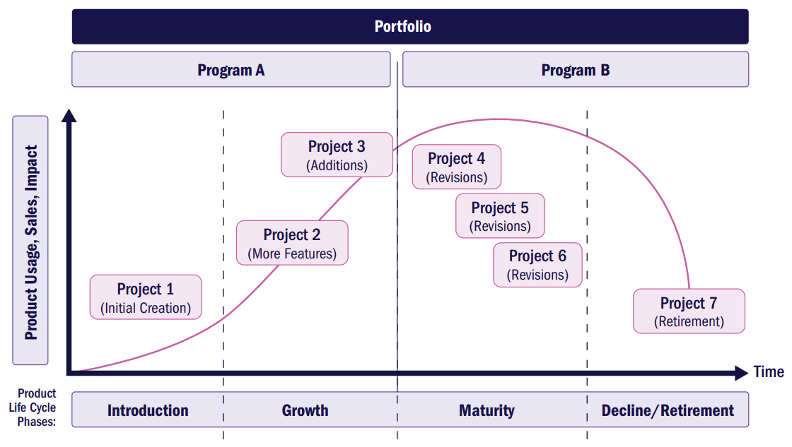

Slide 38
A collection of strategic business activities aimed at building, sustaining, and/or advancing an organization. Portfolios, programs, projects, products, and operations can all be part of an organization’s system for value delivery.

Slide 39
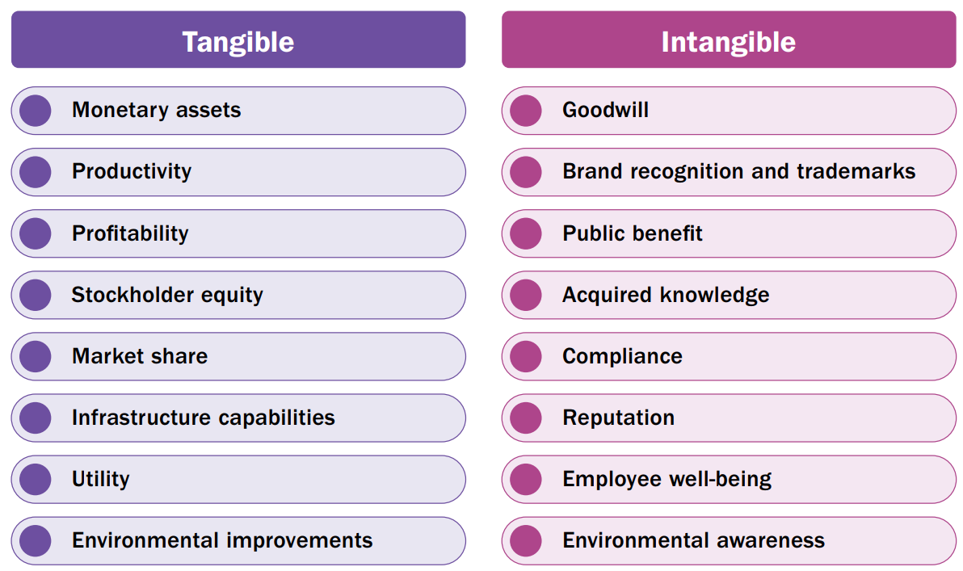

Slide 40
Value include
Customers : value as the ability to use specific features or functions of a product.
Organizations determined value as with financial metrics, such as the benefits less the cost of achieving those benefits.

Slide 41
Information Flow
A value delivery system works most effectively when information and feedback are shared consistently among all components, keeping the system aligned with strategy.

Slide 42
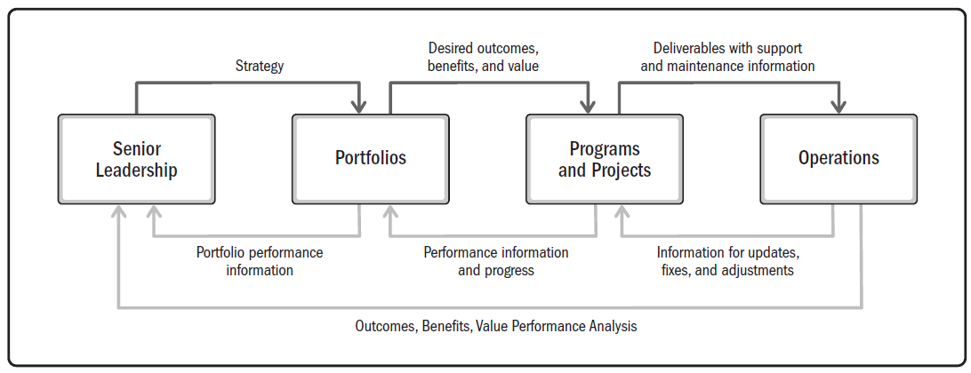

Slide 43
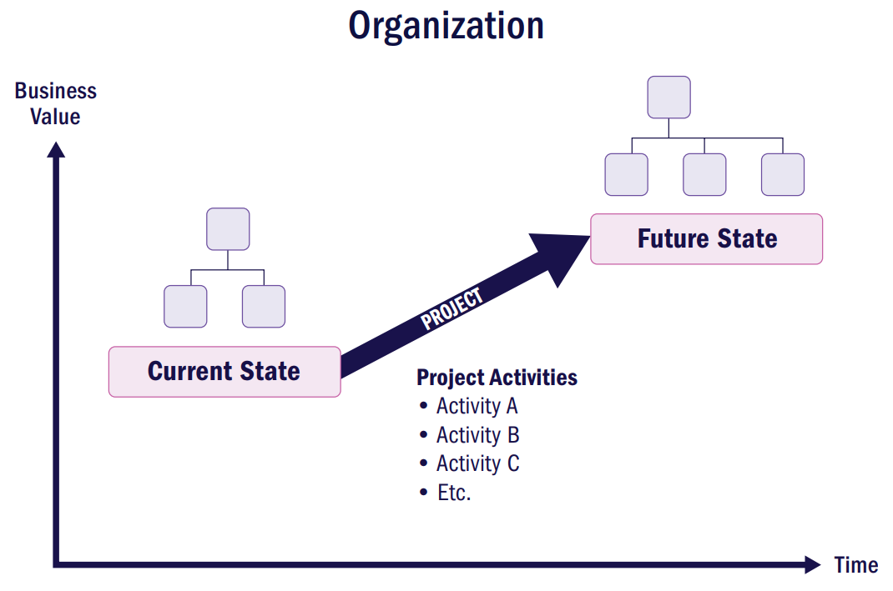

Slide 44
Thank You

